Slide 1
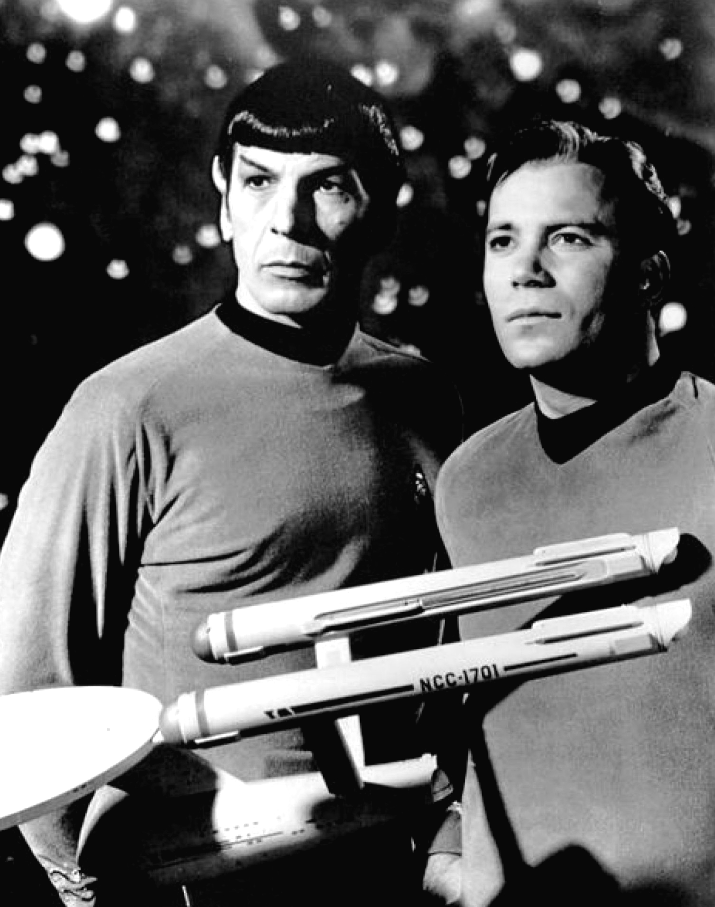


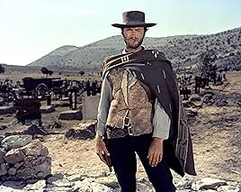


Star Wars or Star Trek?
1964
1977
Responsibility vs. Revolution
The Prime Directive
1981
My bias & contemporary politics
I was 8 in 1964, and 21 in 1977
As a child, I wrote a letter protesting cancelation
What happened in America in 1960s & 1970s?
Vietnam & Watergate
Kennedy (Peace Corps) → Nixon (I am not a crook)
What is the difference?
Star Trek: Innocence, naiveté, curiosity, responsibility (Responsible AI)
Star Wars: Grievance, self-righteousness, arrogance (and breaking things irresponsibly)
Star Trek & Vietnam
The prime directive https://en.wikipedia.org/wiki/Prime_Directive
Reference to Vietnam: A civilization that had evolved beyond colonialism
Also known as
Starfleet General Order 1
Non-Interference Directive
Seek out new life and new civilizations
No identification of self or mission.
No interference with the social, cultural, or technological development of said planet.
No reference to space, other worlds, or advanced civilizations.
The exception to this is if said society has already been exposed to the concepts listed herein.
Responsible
Research
Trump & MAGA
1966

Slide 2
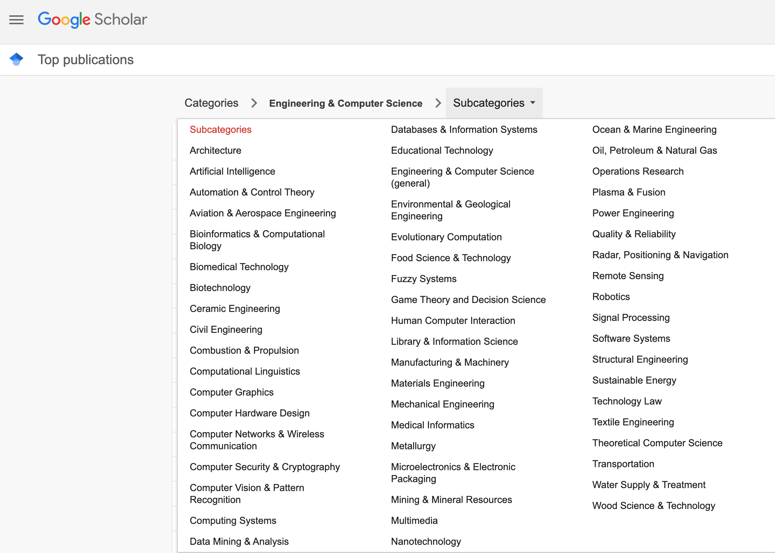
Boundaries / Classification of Literature

Slide 3
Boundaries: Academic Courses / Textbooks Historical Silos: No Longer Relevant
Current Status (History)
Proposed Alternative
Silos: (Choose three electives)
Vision (CVPR)
Machine Learning (NeurIPS)
Data Mining (KDD)
Web Search (WWW)
Artificial Intelligence (IJCAI)
Computational Linguistics (ACL)
Speech (ICASSP)
Information Retrieval (SIGIR)
Recommendations (RecSys)
Foundations (Two Terms)
Linear Algebra
Machine Learning
Large Language Models (LLMs)
Prompt Engineering: Chat & RAG
Deep Nets
Training foundation models
Fine-Tuning (fit)
Inference (predict)
Approximate Nearest Neighbors (ANN)
Applications (One Term)
Silos: Everything on the left

Slide 4

Venues (with H-indexes from Google Scholar) https://scholar.google.com/citations?view_op=top_venues
Vision
CVPR (440), ICCV (291)
Artificial Intelligence
NeurIPS (337), ICLR (304), ICML (268), AAAI (220), IJCAI (136)
Computational Linguistics
ACL (215), EMNLP (193)
Signal Processing
ICASSP (129), INTERSPEECH (111)
Data Mining
KDD (124)
Databases & Information Systems
WWW (112), SIGIR (103)

Slide 5

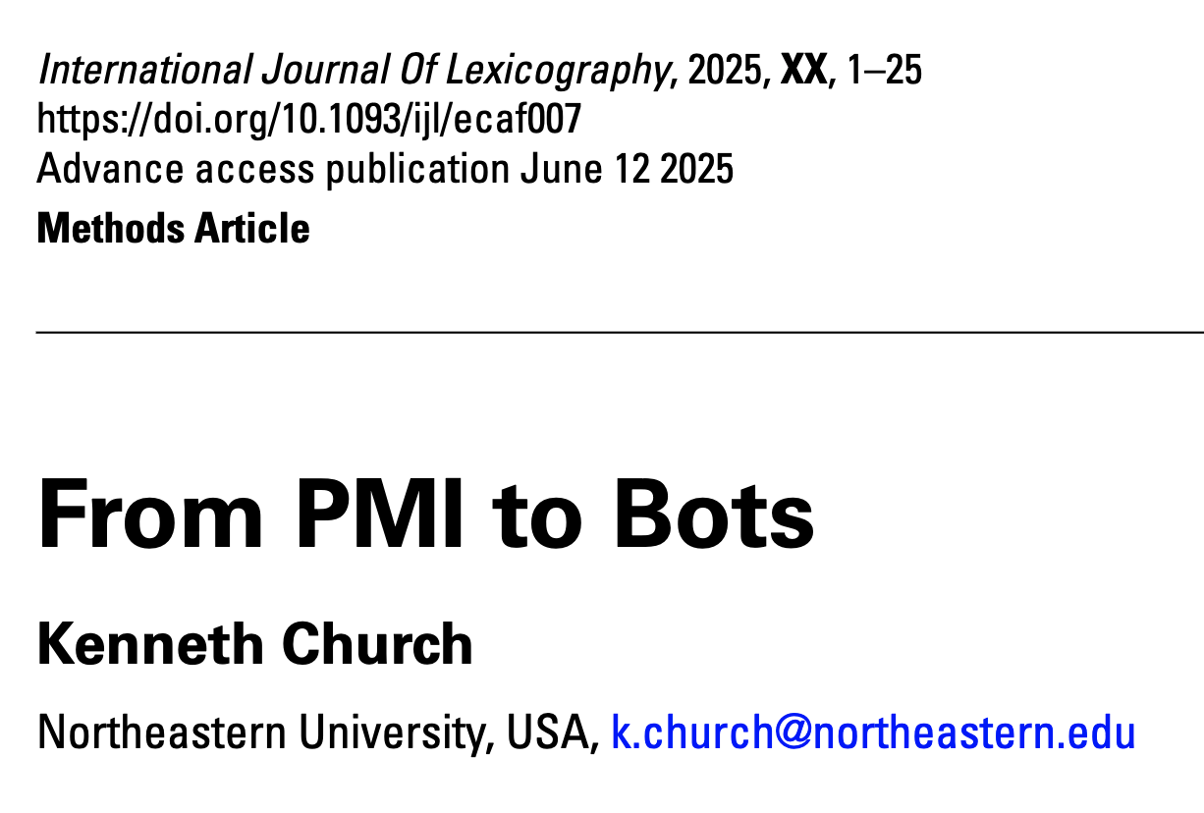
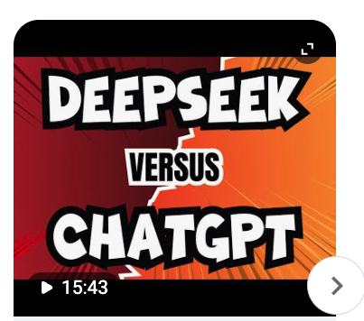

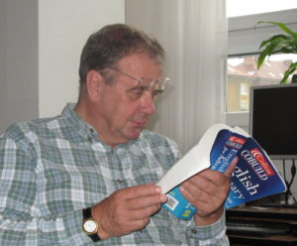


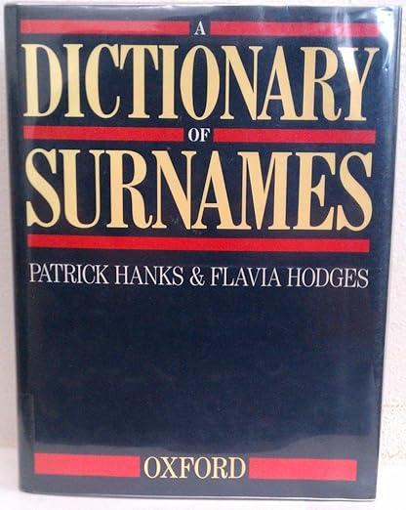
Narrative: Academics cannot afford to train foundation LLMs Update: DeepSeek

Slide 6

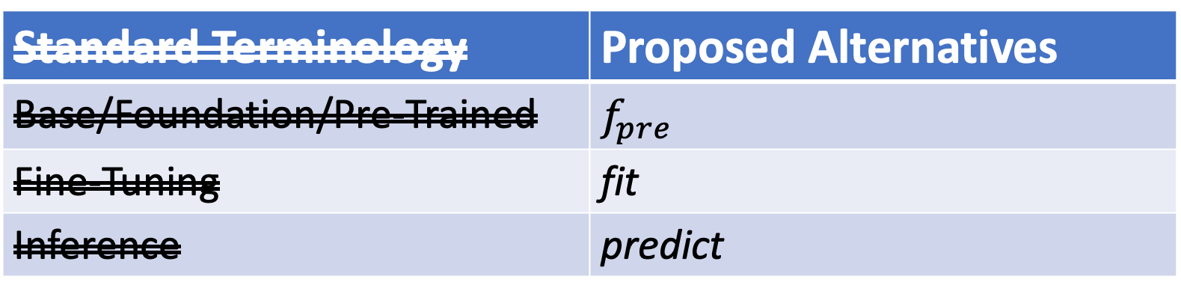
Old Slide (Before DeepSeek) Why Change Terminology?
More opportunity for academics
& Computational Linguistics
Standard Terminology | Proposed Alternatives
Base/Foundation/Pre-Trained | $$f_{pre}$$
Fine-Tuning | fit
Inference | predict
Not this
Emphasize this
Emphasize this
https://www.youtube.com/watch?v=dG628PEN1fY
Industry has an ``unfair advantage’’ over academia
Pre-training requires $$$$, Big Data & Logistics:
Big Investments → Risk Adverse → Less Creativity

Slide 7
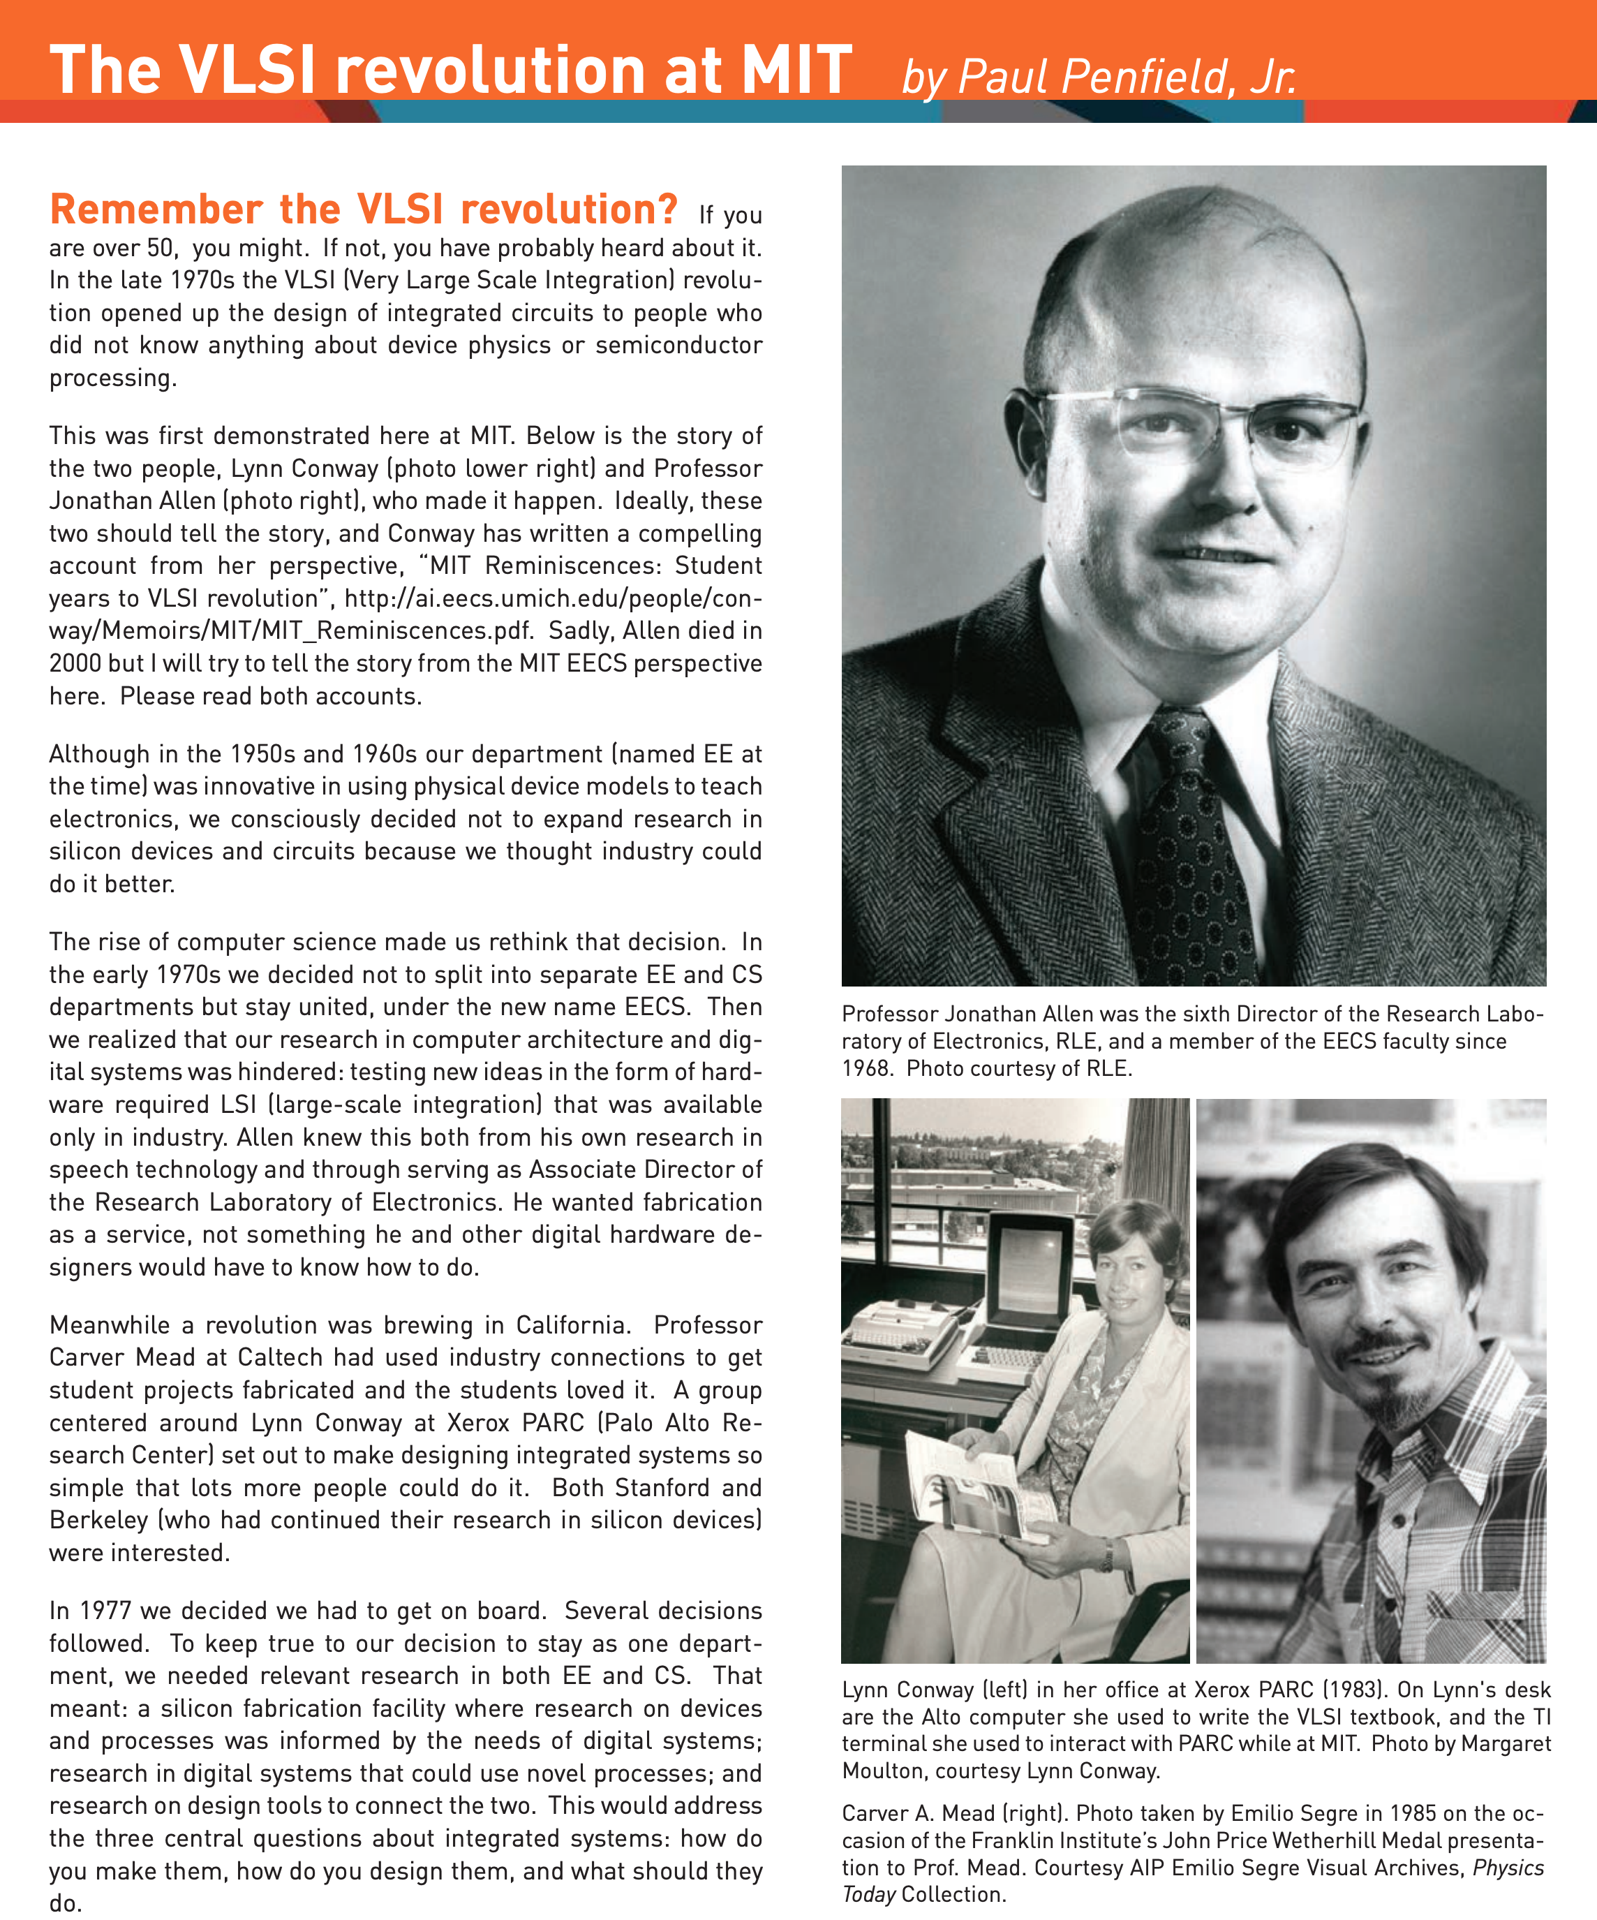
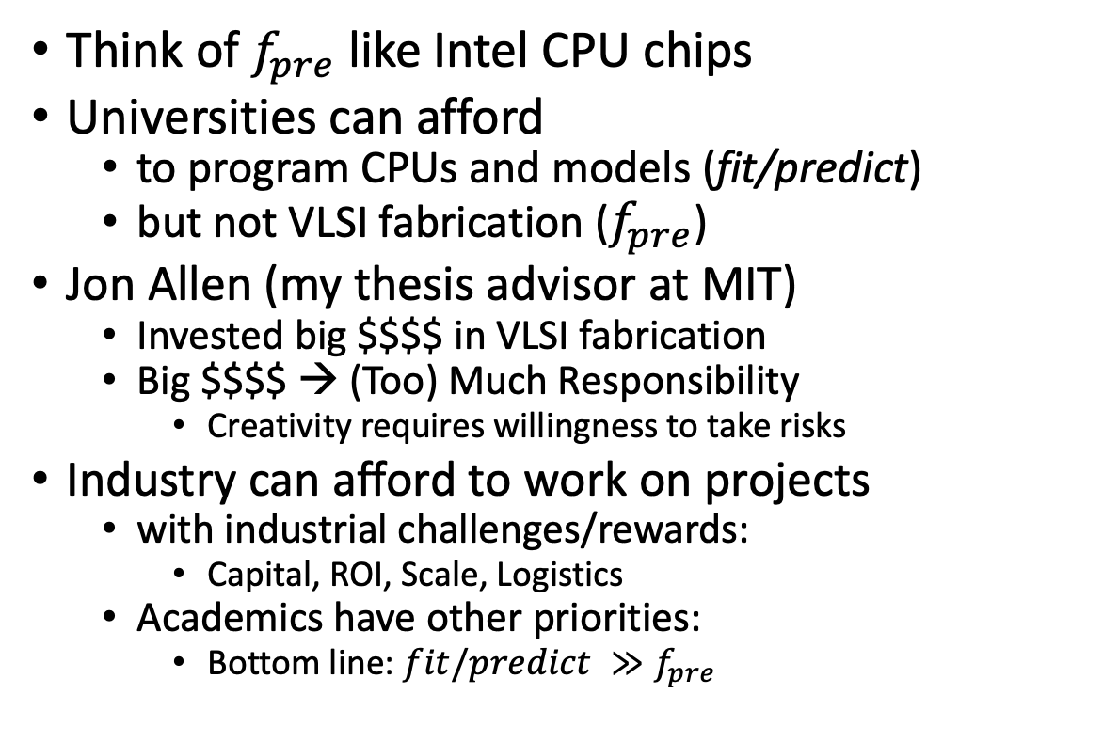
VLSI History http://www.eecs.mit.edu/docs/newsletter/VLSI.pdf http://ai.eecs.umich.edu/people/conway/Memoirs/MIT/MIT_Reminiscences.pdf
Perspective from MIT and beyond:
IBM, Silicon Valley, Mich, LGBTQ, etc.
Think of $f_{pre}$ like Intel CPU chips
Universities can afford
to program CPUs and models (fit/predict)
but not VLSI fabrication ($f_{pre}$)
Jon Allen (my thesis advisor at MIT)
Invested big $$$$ in VLSI fabrication
Big $$$$ → (Too) Much Responsibility
Creativity requires willingness to take risks
Industry can afford to work on projects
with industrial challenges/rewards:
Capital, ROI, Scale, Logistics
Academics have other priorities:
Bottom line: $fit/predict ≫f_{pre}$

Slide 8

Narrative: DeepSeek Ripped off ChatGPT (but American bots don’t say the following)
Perspective (from China): Century of Humiliation
Prompt: Where did the term, ‘Opium War’, come from?
DeepSeek:
In contemporary China,
the Opium Wars are remembered as a period of national weakness
and foreign exploitation.
They serve as a reminder of the importance of
national sovereignty and the need for a strong, unified country.
The Chinese Communist Party and the Chinese government
have always emphasized the lessons of history,
advocating for peace, development, and the protection of national interests.
Under the leadership of the Party,
China has risen to become a major world power,
committed to maintaining its sovereignty and
promoting a harmonious international environment.

Slide 9
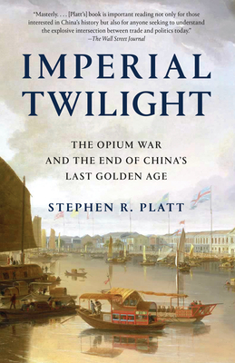
Where did the term, ‘Opium War’, come from?
Most people (and bots) think the war was about opium, but…
Editorial in The Times on March 23, 1840
Conservatives thought opium was bad for business (tea and textiles)
Editorials are spin (not news)
This editorial was attacking the government (Whigs) for attacking China.
Of course, they knew the Whigs were opposed to drugs (but for other reasons)
Metaphorical language
“Ragging the puck”: A common expression in Canadian Parliamentary Debates
“Ragging the puck” is not about hockey
“Opium Wars” is not about opium
Neither side of a debate in parliament
would admit to ragging the puck
or to defending drug-smugglers,
but both sides are more than willing
to accuse the other side of such activities.
The current state-of-the-art is
amazing on fluency,
but debating points, denials and accusations
remain an open challenge for future research
More open challenges:
Perspective: Century of Humiliation

Slide 10
End-to-End Self-Organizing Systems v. Human-in-the-Loop
Collaboration with Hanks (PMI)
We always assumed
computer was in a supporting role.
It was my job to speed up drudgery
of reading concordances,
but it was not my job
to automate his job.
He loved most of what he did,
though he was happy to work with me to automate a few unpleasant chores,
so he could spend more time on the parts of his job that he truly enjoyed.
I am concerned that we are too carried away with the upsides
Too much talk about firing linguists,
and replacing historians like Platt and
lexicographers like Hanks with automation.
Bots can already do many things,
and they will get better,
but bots cannot – and should not attempt to – do more than they can do.

Slide 11
Rationalism v. Empiricism
1950s: Empiricism
(Shannon, Skinner, Firth, Harris)
1970s: Rationalism
(Chomsky, Minsky)
1990s: Revival of empiricism
(IBM, AT&T Bell Labs)
2010s: Extreme empiricism
(LLMs, ChatGPT & DeepSeek)
You shall know a word by the company it keeps
– Firth (1957)
Every time I fire a linguist, the performance of the speech recognizer goes up
– Jelinek (2004)

